Slide 1
Swedish libraries respond
to Ukranian refugees’ crisis, and the refugee crisis in 2015.
Vänersborg
August 25-26, 2022

Slide 2
2015
162 877 asylum seekers in Sweden
19 373 to the region of Västra Götaland (2/3 were men)
6 232 came to Gothenburg (population: 700 000)
645 came to Vänersborg (population: 39 000)
Mostly from Syria and Afghanistan

Slide 3
What needs did we see?
Practical:
Prints/scanning
(passports, application documents, account statements etc.)
Computer skills (varying!)
Education (language, work, knowledge of the Swedish society)
Living accomodation (problems for young people to share rooms with adults)
Lack of money, clothes etc.

Slide 4
What needs did we see?
Social:
Language (the key to enter society)
Thoughts and questions about religion
Understanding the Swedish mentality and culture
Loneliness and fear for/of family left behind
Need of counceling

Slide 5
What could the library provide?
Litterature - purchase of books for new beginners in Swedish
- purchase of books in different languages
Library as a meeting place! - public living room
- crowded living
- sozialisation

Slide 6
What could the library provide?
Special arrangements:
Easy reader bookcirkels
Collaborations with external actors working with young refugees
Themed evenings
Open stage
Art exhibitions

Slide 7
Ukraine
June, 2022:
38 000 refugees in Sweden (80 000 expected in 2022)
Over 250 placed in Vänersborg
(200 in the Migration agency’s facility accomodation, 50 in private housing)

Slide 8
Library service
Books in Ukrainian and Russian
In march – sold out in all of Sweden
Massive need for printing of books
Available in April at our library

Slide 9
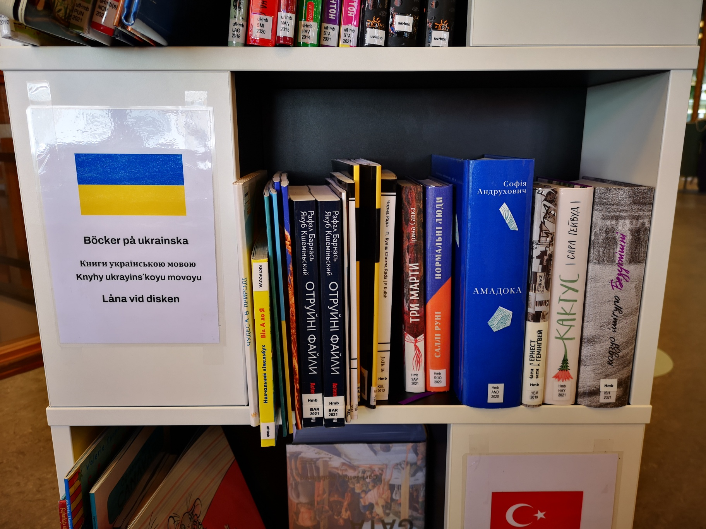
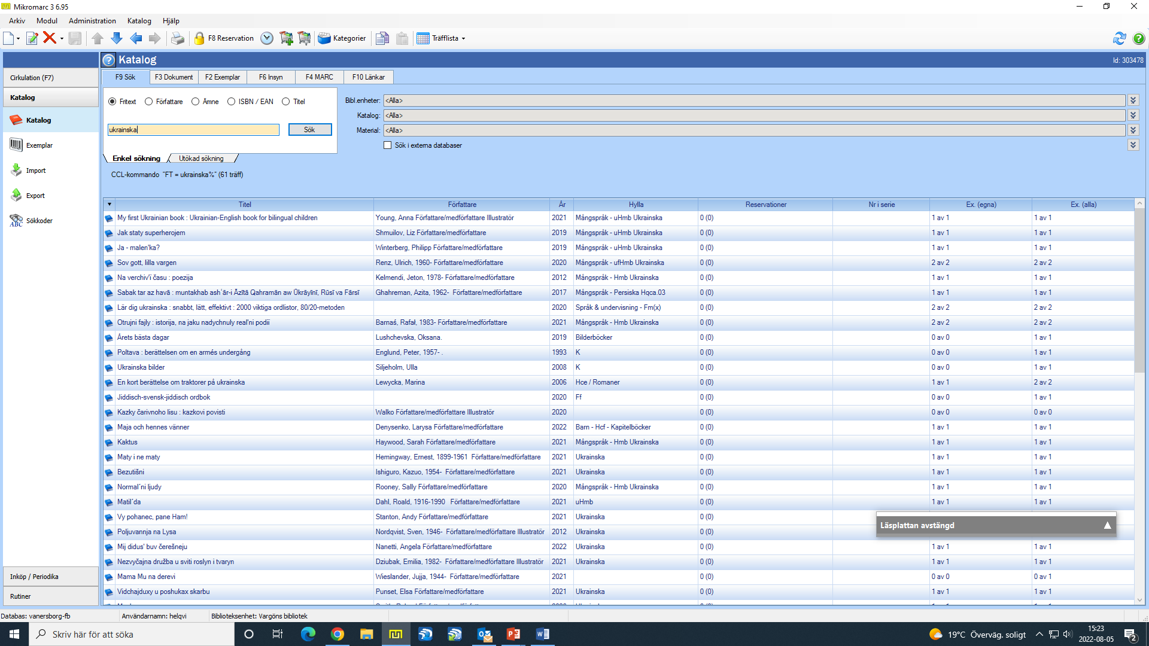

Our Ukranian bookshelf so far
$$←$$
Vänersborgs kommun - attraktiv och hållbar i alla delar, hela livet

Slide 10
What has been asked for?
Litterature: Easy reading and children’s books in Swedish
Ukrainian litterature
Russian litterature
Access to computers
Prints/scanning

Slide 11
Vänersborgs library
Still closed for renovation
When we are open – easier access to everything, closer for our patrons etc.
Possible events:
Community information at the library
Book circle
Language café

Slide 12
Presentators
Anders Olsson
Librarian
Culture and leisure administration
Phone: +46521 72 14 44
E-mail: anders.olsson@vanersborg.se
Helena Qvist
Librarian
Culture and leisure administration
Phone: +46521-72 14 40
E-mail: helena.qvist@vanersborg.se
Vänersborgs kommun - attraktiv och hållbar i alla delar, hela livet

